Slide 1
SEXUALITY AND DEVELOPMENTAL DISABILITIES: A WORKSHOP FOR PARENTS AND GUARDIANS
Leah Janke, DSA Executive Director
Denise Gehringer, DSA Board V.P.,
Parent Advocate

Slide 2
In Nov. 2018 Leah and Denise completed the Assessment Based Certificate Program: Sexuality and Developmental Disabilities; Becoming a Sexuality Educator and Trainer, a three-day, 22 hour training by ELEVATUS
This training qualifies the participant to:
Lead sexuality education series for people with developmental disabilities.
Lead trainings for other agency staff on how to address sexuality one-on-one with people with developmental disabilities.
Lead parent trainings on “How to Talk with your Kids with Developmental Disabilities about Sexuality.

Slide 3
SEXUALITY: PROTECTING BOUNDARIES
Talking with our young and grown children about sexuality can be a difficult task.
As parents and guardians, we often worry whether talking about it gives permission and whether they can be safe from harm when they are in relationships.
This workshop will help you become more comfortable discussing this topic by covering what topics to cover when and the most effective ways to talk about this sensitive topic.

Slide 4
OBJECTIVES:
1. Examine Barriers to talking about sexuality
2. Gain knowledge about sexuality and developmental disabilities
3. Acquire and practice skills in communicating about sexuality with our young and grown children

Slide 5
WHY IS IT IMPORTANT TO TALK ABOUT SEXUALITY?
Normalizes Sexuality
Sets a pattern of communication
Ignoring can lead to negative thoughts about sexuality
Gives positive messages verses negative one
Increases self esteem when we know and understand about our bodies
Increases trust between child and parent when they know they can ask questions and get accurate information form home
Combats all of the inaccurate and unrealistic messages our media sends young people

Slide 6
WHY IS IT IMPORTANT TO TALK ABOUT SEXUALITY? (CONT.)
No sexuality education in some schools
Can express our own values that will be input for the children when forming their own beliefs
Teens are more likely to wait to have sex and if choose to have sex, use protection if their parents discussed sexuality with them while they are growing up
Increases the possibility that the child will have needed skills to be in relationships
Will help our children be sexually healthy
Reduce Sexual Abuse

Slide 7
Some people with intellectual disability may have fewer opportunities to form social and sexual relationships for a number of reasons, including:
a lack of privacy
being dependent on others for daily living
a lack of confidence about their physical appearance and ability
less knowledge of how to negotiate relationships and express their sexuality
a limited social circle and a lack of social experience
physical or cognitive limitations
Caregivers who wrongly think of them as childlike or asexual
Caregivers who view their sexuality as something to be feared and controlled.

Slide 8
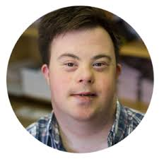
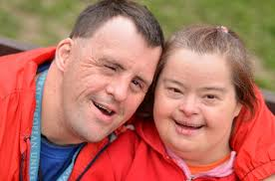
HERE ARE SOME REASONS WHY PEOPLE WITH DEVELOPMENTAL DISABILITIES THINK IT IS IMPORTANT TO HAVE ACCESS TO SEXUALITY EDUCATION. SELF ADVOCATES SAY:
"So we can learn to have healthy relationships”
“So we aren’t lonely!”
"So we are able to make informed choices!”
"So we can pick the right person!”
"For help with the toughest part of the relationship, making it last!”
"So we can be safe!”
"Because we all have desires/needs and that’s okay!”
"To get correct information!”
"To get resources and tools to make healthy sexual choices!”
"So that people know their rights!”
"So people with disabilities don’t put themselves in bad situations!”
"So we will know how to protect ourselves!”
“So we can feel good about ourselves and our bodies!”
“So we can be sexual self advocates, not just self-advocate.”

Slide 9
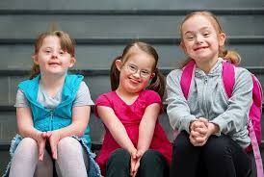
SEXUAL HEALTH MEANS:
Feel good about their bodies and have high self esteem
Have relationships that are positive and not exploitive
Have information to make esteem healthy decisions about their lives, bodies, etc.
Avoid STIs and Pregnancy
Not violate others
Feel good about their gender
Developing out sexual health starts young-we receive many messages, both positive and negative, and have experiences that shape our sexual health.

Slide 10
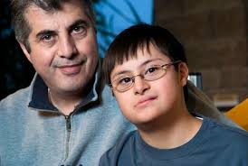
WHY WE ARE ALL HERE
I think we are all here because we know it's important to discuss, but what we hear over and over again from parents is that it is difficult. Our goal is for you leave more comfortable with this topic. Some of you may feel comfortable and will get some new ideas. Some of you may feel really uncomfortable, but will leave with some ideas of how to start communicating about this topic.
What we are going to do is to look at what makes if difficult and discuss those reasons, learn some tips, and take time to practice.

Slide 11
GROUP AGREEMENTS
Respect differences of opinion
Confidentiality
No such thing as a stupid question
Have fun
Notes:
Respect differences of opinion
Stay out of the weeds and the swamps
Confidentiality (whatever is said/written in the room stays in the room)
Bring your humor and have fun!

Slide 12
TURN TO THE PERSON NEXT TO YOU AND DISCUSS:
What was the primary message you got about sexuality growing up?

Slide 13
EXAMPLES OF MESSAGES:
Good girls don't do it
Wait until you're married
Men should be strong, etc.
Don't talk about it
It's dirty, shameful
Your answers?

Slide 14
WHAT IS SEXUALITY?
Sexuality means more than intercourse or sex.
lt's about intimacy, connection, and belonging.
lt's about relationships. Friendships and sexual.
lt's about how we feel about being the gender we are.
lt's about how we feel about others and ourselves.
lt's about sexual expression and behavior.
lt's the total of who we are, what we believe, what we feel, and how we respond.

Slide 15
WHAT MAKES IT DIFFICULT?
What are the reasons it can be difficult to talk about sexuality with our kids??
Let’s list our answers!

Slide 16
The message we received about sexuality were mostly negative.
This affects our ability to talk about it. We may think it is something that is dirty or maybe think it's very private and not to be discussed.
These old messages can get in our way when we are trying to talk with our children about the topic.
lt's important to try to replace these old messages with positive messages about sexuality. lt is okay to talk about it.
Our children need information about sexuality to have safe and happy lives.
Now, we are going to think about other reasons it's
hard to talk about it with our children.

Slide 17
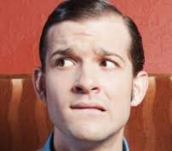
THIS MAKES IT DIFFICULT:
No role models
Embarrassed
Don't know how
What's too much, too little
What's age appropriate information?
No one talked with us
Negative messages about talking
Don't know the answers

Slide 18
THIS SHOULD HELP US BECOME MORE COMFORTABLE TALKING ABOUT THE TOPIC.
Now we will focus on the role of the parent, sexual development, tips for discussing this topic, and we'll take some time to practice.

Slide 19
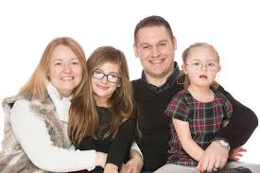
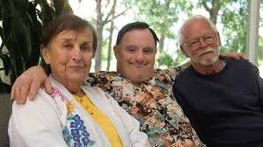
ROLE OF THE PARENT:
Provide information
Listen
Model
Support
Answer questions honestly
Respond in a positive way about sexuality

Slide 20
HUMAN SEXUAL DEVELOPMENT
Development of Biological Sex
Gender Assignment
Development of Gender Identity & Societal Gender Role
Development of Values and Attitudes About Sexuality
Physical and Emotional Changes of Puberty
Development of Sexual Orientation
Affectional Attraction/ Romantic Attraction/ Erotic Attraction
Development of Sexual Behavior
Development of Sexual Identity
Development of Sexual Knowledge
Development of Sexual Skill

Slide 21
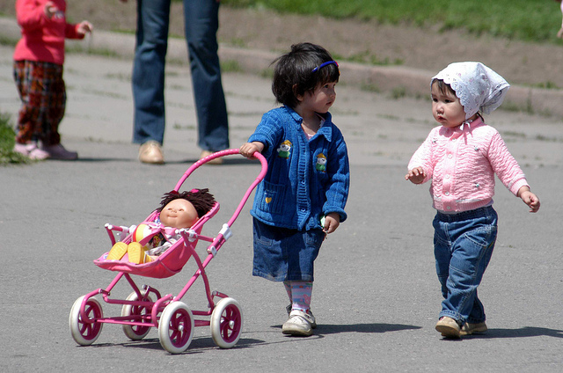
SEXUAL INTERESTS AND CONCERNS
SEXUAL INTERESTS AND CONCERNS OF YOUNG:
Body parts and functions
Genital touching, Sex play
Reproduction: “Where did I come from?”
Roles as male/female
Body image
Need for privacy increases

Slide 22
SEXUAL INTERESTS AND CONCERNS (CONT.)
SEXUAL INTERESTS AND CONCERNS OF ADOLESCENTS:
Physical changes of puberty
Hygiene: pimples and body odor
Friendships
Reproduction, Pregnancy, Birth, Pregnancy
Options Sexual Expression
Contraception and Sexually Transmitted Infections
Sexual feelings
Masturbation
Sexual Orientation
Gender Identity
Body Image
Establishing and maintaining intimate relationships: Ways of expressing affection/ How to communicate with their partner/ Deciding about having sex
Breaking Up

Slide 23
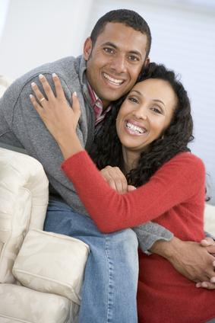
SEXUAL INTERESTS AND CONCERNS (CONT.)
SEXUAL INTERESTS AND CONCERNS OF ADULTS:
Pregnancy, Birth
Parenting Contraception, Sexually Transmitted Infections
Masturbation
Sexual Orientation, Gender Identity
Establishing and maintaining intimate relationships
Separation/Divorce
Body Image
Menopause
Changes in sexual functioning

Slide 24
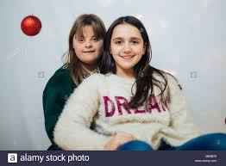
HOW ARE CONCERNS THE SAME FOR PWD?
Assigned gender
Gender roles reinforced
Biological changes
Need same information, based on biological age
Have sexual feelings and needs
Have dreams like anyone else might, relationship, babies

Slide 25
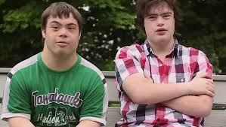
HOW ARE CONCERNS DIFFERENT FOR PWD?
People don’t discuss topic
Think there are oversexed
Higher rate of abuse
Behaviors are accepted or forgiven
Lack friendships, social opportunities
Don’t pick up on the social cues
How you teach topics is different
Often lack privacy to explore their sexuality (constantly supervised/group living)
Many parents let go of dreams for child related to sexuality or think of them as not sexual

Slide 26
TOPICS TO TEACH BASED ON THE PERSON'S BIOLOGICAL AGE, NOT THEIR COGNITIVE AGE
SOCIAL SKILLS:
Difference between family, friends, acquaintances, and strangers
Appropriate Behavior and Touch
Public/private
Modesty and Nudity
Appropriate Dress
Personal Hygiene
Phone Etiquette
Dining skills

Slide 27
TOPICS TO TEACH BASED ON THE PERSON'S BIOLOGICAL AGE, NOT THEIR COGNITIVE AGE
FRIENDSHIP SKILLS:
Making and keeping friends
Initiating conversations
Active listening
Understanding emotions (verbal, non-verbal)
Finding similarities

Slide 28
TOPICS TO TEACH BASED ON THE PERSON'S BIOLOGICAL AGE, NOT THEIR COGNITIVE AGE
PHYSICAL HEALTH AND EMERGING SEXUALITY:
Being Male and Female
Body Parts and Functions
Puberty Changes
Reproduction, Pregnancy, and Birth
Sexual Abuse Prevention
Sexual Feelings, Masturbation
Sexual Expression and Pleasure
Sexual Orientation
Body Image and Self-esteem

Slide 29
TOPICS TO TEACH BASED ON THE PERSON'S BIOLOGICAL AGE, NOT THEIR COGNITIVE AGE
RELATIONSHIP SKILLS:
Asking out on a date
Dealing with Rejection
Giving and Receiving Compliments
Compromise
Resisting Persuasion
Decision Making and Setting Limits
Communication Skills and Sexual
Behavior
Consent
Birth Control
Sexually Transmitted Infections
Decisions about Family/Becoming a parent

Slide 30
TIPS FOR TEACHING:
You may have to initiate.
It's okay to feel embarrassed, not to know the answer, and answer the question later.
Use a "private" tone, in a private place.
Give age appropriate information.
Use models, visuals, T.V., soap operas, role-plays, and scenarios.
Try to give a consistent message.
Try not to react.
Practice.
Use teachable moments.

Slide 31
FACTUAL: TEACHABLE MOMENTS
1. Reassure the person that it is good to ask questions.
2. Find out what the person thinks/is really asking.
3. Decide what message you want to give.
4. Answer the question simply, using correct vocabulary.
5. Encourage the person to give feedback
*The Center for Sex Education, www.SexEdCenter.org

Slide 32
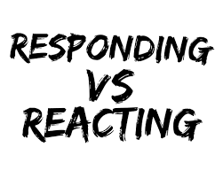
RESPONDING TO BEHAVIORS
1. Decide first if it is better to ignore the situation. If ignoring the situation is inappropriate, then continue with the following steps…
2. Name the behavior/comment to the person(s) as you see or hear it; praise if appropriate.
3. Find out the meaning of the behavior/comment to the person(s).
4. Decide what "messages" you want to give.
5. Give the messages by responding simply.
6. Encourage the person(s) to give you feedback.
*The Center for Sex Education, www.SexEdCenter.org

Slide 33
SCENARIOS
You are at McDonald's having lunch with your son. When you return from using the restroom, you find your son touching his genitals at the table. How do you respond?
While you are at the grocery store, you see your son hug the store clerk. How do you respond?
Your daughter says that she wants a boyfriend so she can have sex with him. How would you respond?

Slide 34
WRAP-UP
What is a positive messages that you want to give your kids about sexuality?

