Slide 1

Addressing Challenges with Children focusing on Social and Emotional Competencies

Slide 2


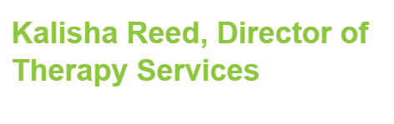
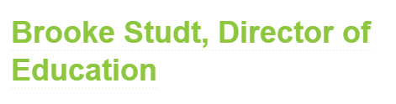



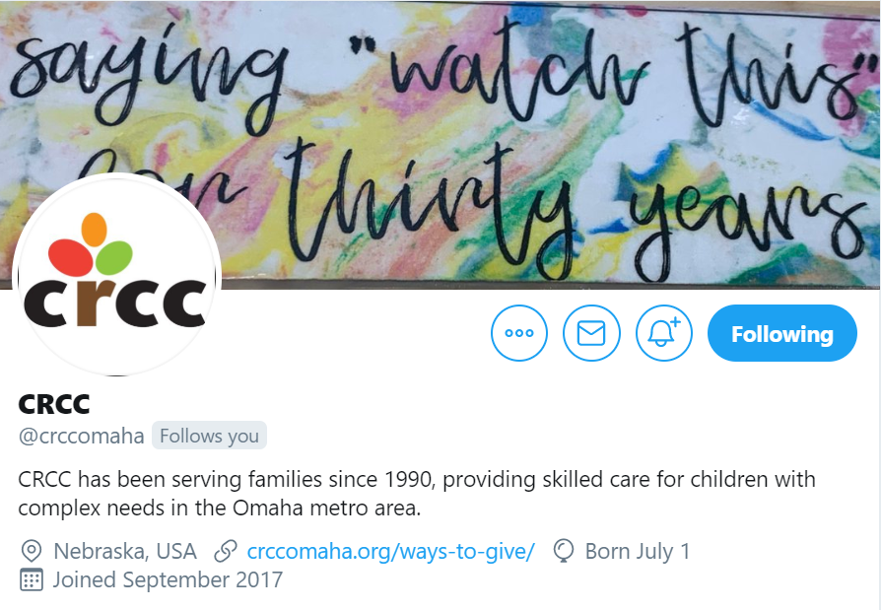


Notes:
Introduce ourselves.
Explain that Zoom is a new platform for our presentation. We are going to cover SEL and Behavioral Modifications throughout in two part

Slide 3
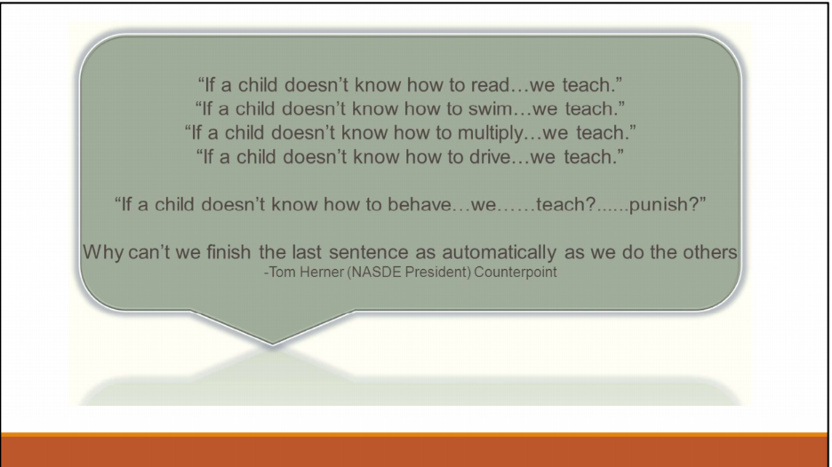
Notes:
Reflect on the quote:

Slide 4

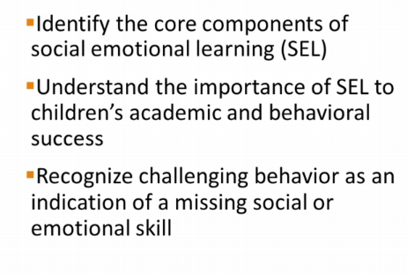
Notes:
Ask the Zoom Attendees to take a minute and identify what Social and Emotional Skills are. This does not have to be formal. It can just be a few words, or even an image of what they think of. Share out on the zoom if they feel comfortable.

Slide 5
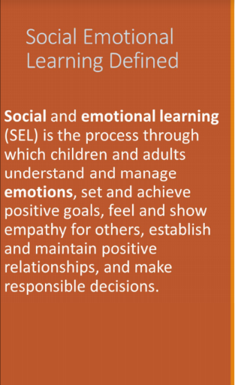
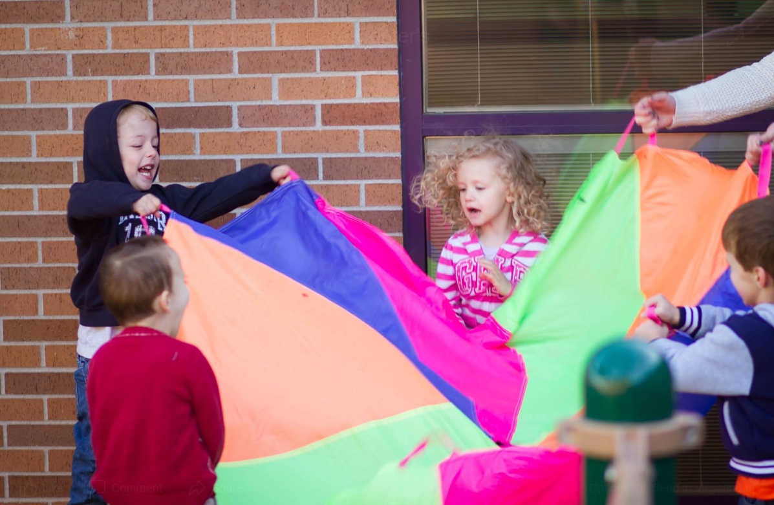

Slide 6
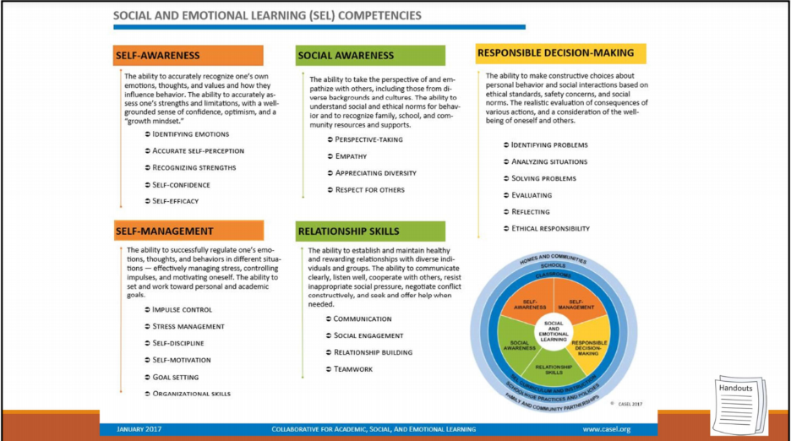
Notes:
Take time to briefly review the competencies of SEL and discuss how each of them link together to build a strong foundation. Today we will do an overarching of the SEL skills and Sensory and how they distinguish behaviors, life skills, and how we can benefit our children from our own understanding and approach and environmental landscape.

Slide 7
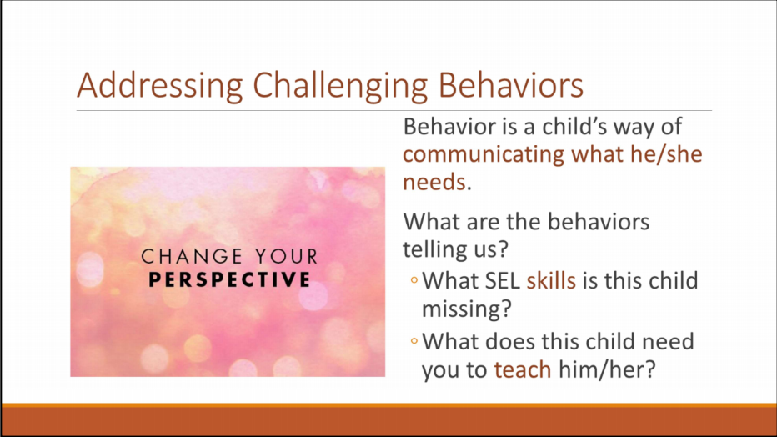
Notes:
We are going to ask you today to reframe your perspective and see if we can use some personal examples to help support children of all ages gain stronger social and emotional skills. It starts with us reframing our lens, and our approach. When we are aware of our own environmental landscape, we are able to be better responsive to others.

Slide 8
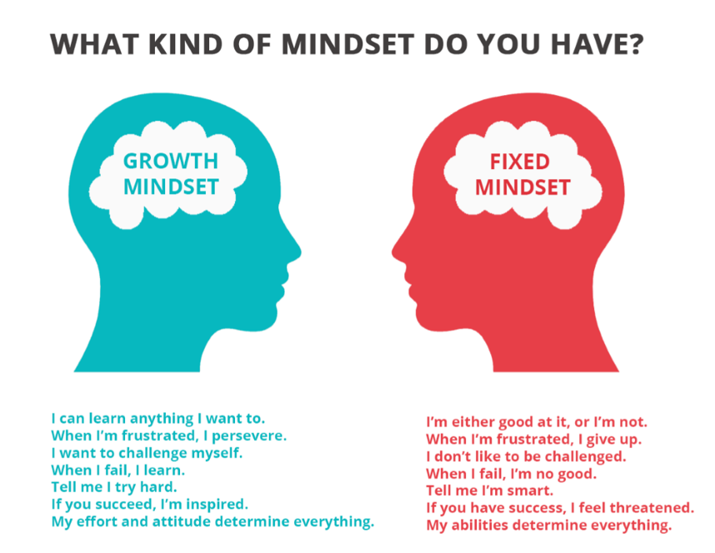
Notes:
This graphic helps distinguish our habits.
-Math example-

Slide 9
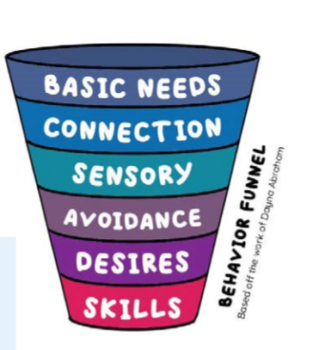
The Behavior Funnel Based off of the work of Dayna Abraham.
Notes:
Explain how the funnel works.
WHO, WHAT, WHERE, WHEN- Basic Needs.
You don’t need to use the behavior spiral with all your kids. You can just use the concept as a tool after the occurrence of an incidence. What might help you remember this strategy the next time you face a challenging problem? If you were to teach this strategy to the parents and caregivers of the children in your class, how might that enable you to work together with them to get to the root cause of a child’s behavior? Or if you are a parent, who in your community or your child’s community can support you in using this strategy?

Slide 10
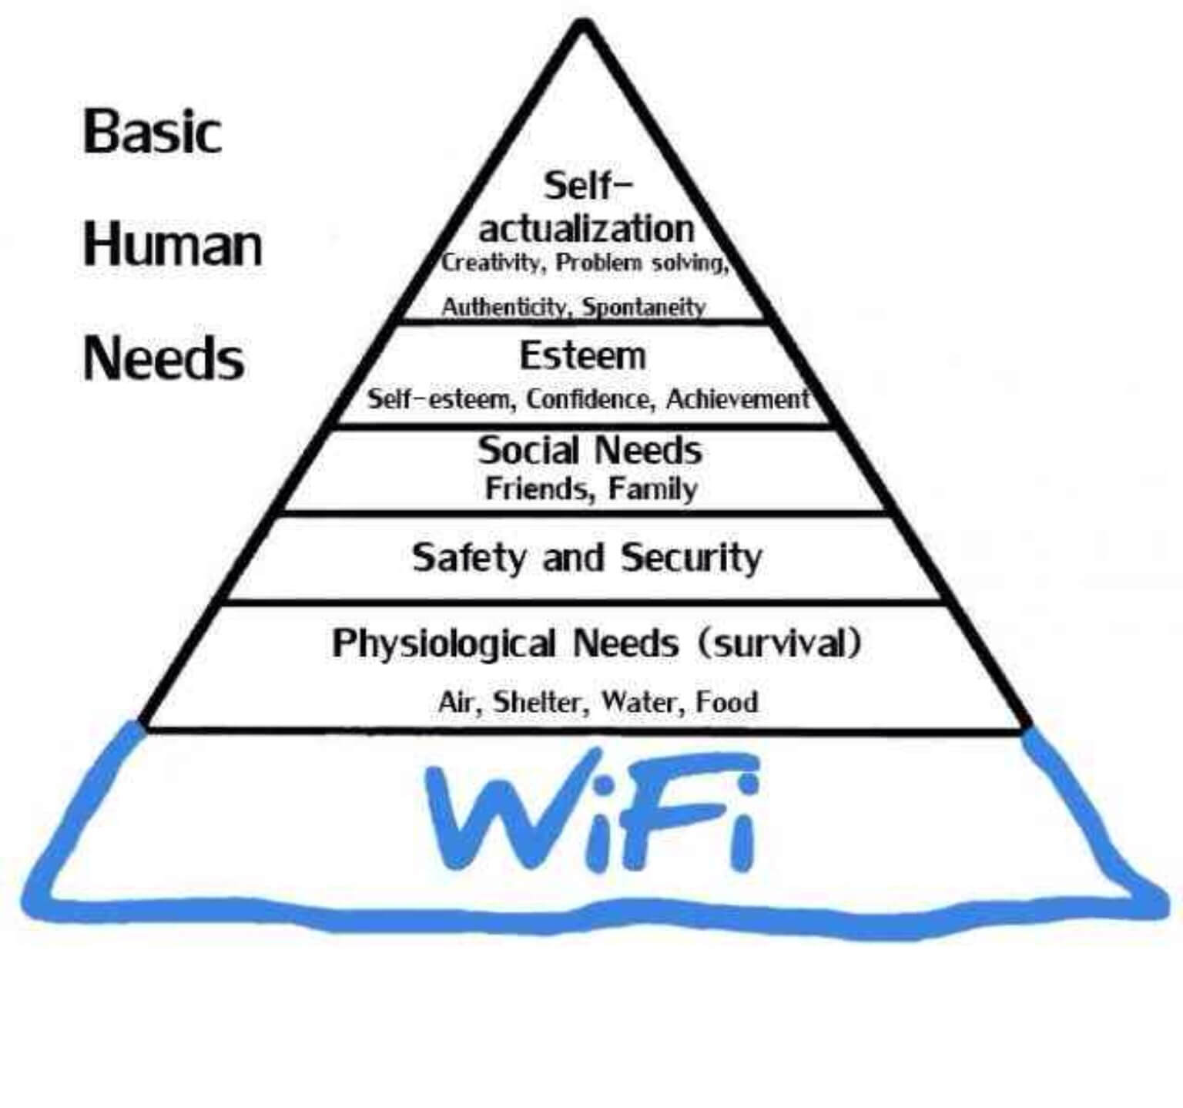
Basic Needs
Notes:
Maslow’s Hierarchy of Needs with an added detail of my own needs. ☺
Who what where and when
Routines
Predictability
Consistency
Talk through changes prior

Slide 11
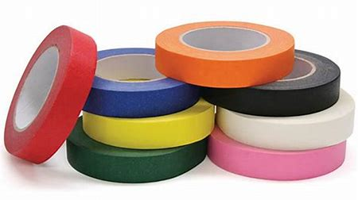
Connection
Notes:
Safety and Security- Try not to judge yourself for not taking the wagon ride, or reading that story before bed, Give yourself Grace. So instead did you turn down the radio in the car, walk to the mailbox together, capitalize on the things you are already doing. Ask if they want to help cook dinner. Parenting mode is hard, but there are simple ways that you can acknowledge you are listening.
We can show kids how to problem solve, by letting them help bake cookies. Slow down, and try and figure out where you can be purposeful to include connection time. It’s not going to be perfect, or happen all the time, but if we are self aware, we are able to be more responsive. Cooking dinner example. One day a week.
Brainstorm ways you connect with your child, or the children you serve. How does a relationship preserve a poor situation?

Slide 12

Sensory
How many senses can you name?

Slide 13
What do senses have to do with social and emotional skills?
Notes:
Brainstorm- These are obvious most of the time. We learned them in school. Most of America is fortunate enough to utilize them in most decisions, experiences, and they frame our mindset for the future.
Rollar Coasters- Love them. They’re fast, the smell of funnel cakes, the screaming in excitement.
Bad- They’re fast, the smell of funnel cakes, the screaming.

Slide 14
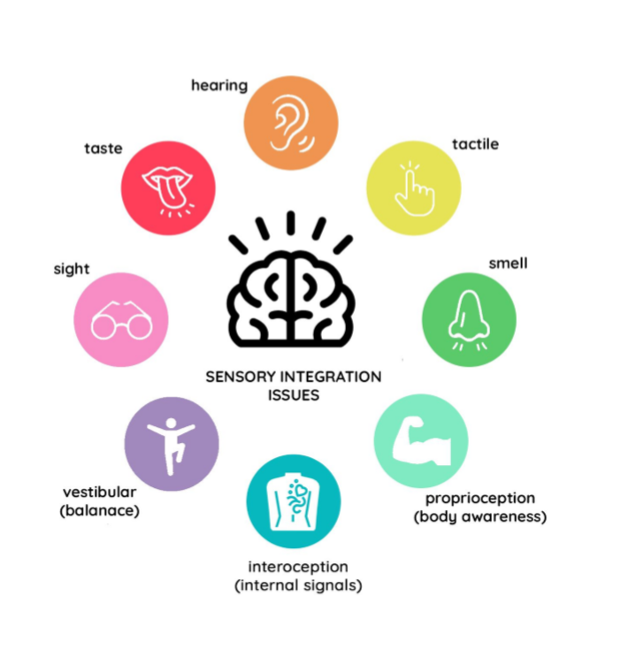
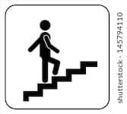
Notes:
Dig Deeper-
Refer back to the roller coaster example. We all have internal signals that guide us. I am going to give you a couple of examples to think about, and I want you to think about your immediate environmental landscape. There is nothing like a quiet Saturday morning, with the smell of coffee, cinnamon rolls baking, birds chirping, the sun is peeking and everyone else in the house is asleep. It immediately relaxes me. What senses did I use?
Walking into a busy Mall. The smell of popcorn or foodcourt, packed with people walking past you fast, music overhead repeating the same Holiday songs you have heard over and over. How do you feel? How does this landscape prepare you for your experience at the mall? It sets the stage.
Desensitize to something
Exposure
Anxiety- Public Speaking- What are five things you could do to prepare for it.
Large Crowds.- you break it down

Slide 15

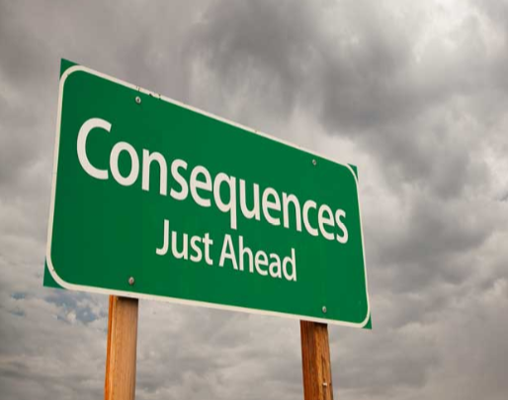

Avoidance
Notes:
Lying, cheating, stealing, sneaking, hiding, anxiety, something is hard, whining, complaining
These are all behaviors that warrant a missing connection or attachment.
“They lie because they think that I say no all the time.”
“ as a parent, you can simplify your life by explaining the why.
Not being able to affectively communicate their needs, and that’s how they naturally respond.

Slide 16
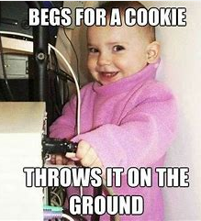
Desires
Notes:
To see how far they can get.
Did they really want the cookie? Or was it the connection? The attention? The hug? They want to do what their mom or dad is doing. Eat off of a big plate. Just like adults- we don’t like when we are treated different. Tune into cues. IS there something else they are desiring that we could accommodate and help build on their skills.
Routine

Slide 17
Skills
Notes:
When you think about what skills you want your children to learn, cope, are they appropriate for the age group and developmentally abilities of all children? Why is it important to remember that learning is non-linear, and just because another child did something (or even one sibling did something) that not all the children will develop along the same timeline?
Skills is at the bottom because we sometimes assume that a child doesn’t have the skills, without considering our own environmental landscape, opportunities that we can create in our normal routine, and

Slide 18


Slide 19
Inclusion
  Provide Every Opportunity for the child to interact with same aged peers at different cognitive abilities.
Building Self-Esteem
  Rephrasing Feedback
  Positive Reinforcement
  Realistic Expectations
Progressive Learning Opportunities
  Support children progressively to new learning
  Never assume they can’t do something
Minimize Distractions
  Environmental awareness
  Sensory
Behavior Management Techniques
  Consistency
  Positive Reinforcement
  Realistic Expectations

